Slide 1
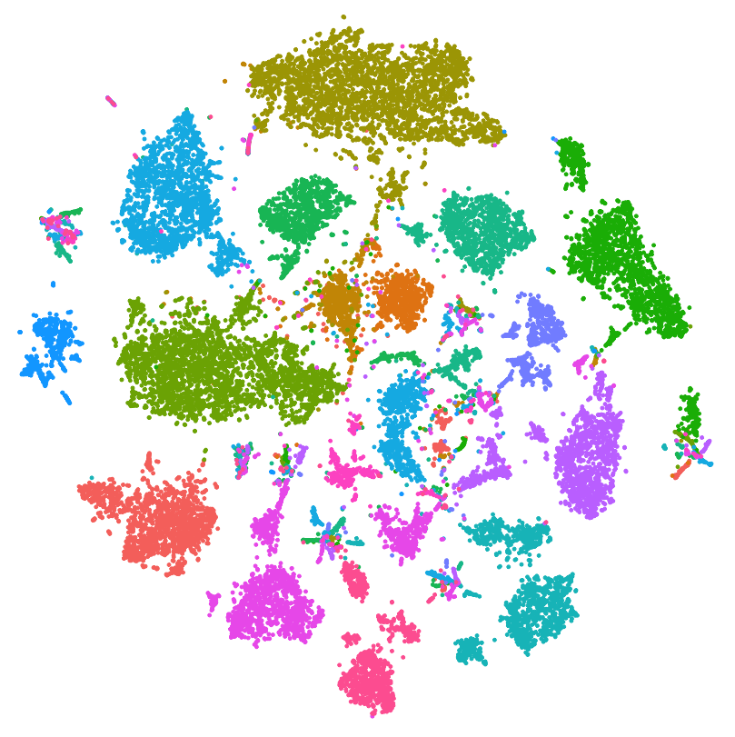
Higher Understanding with Lower Dimensions
GLBIO 2019 Tutorial on Dimension Reduction
Brittany Baur¹, Da-Inn Erika Lee¹,
Xiaotong Liu², Henry Ward²
¹University of Wisconsin, Madison
²University of Minnesota, Twin cities

Slide 2
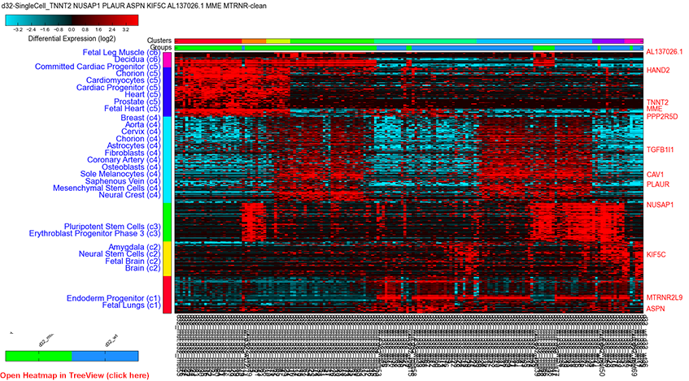


What do we mean by dimension?
$$n$$
$$m$$

Slide 3
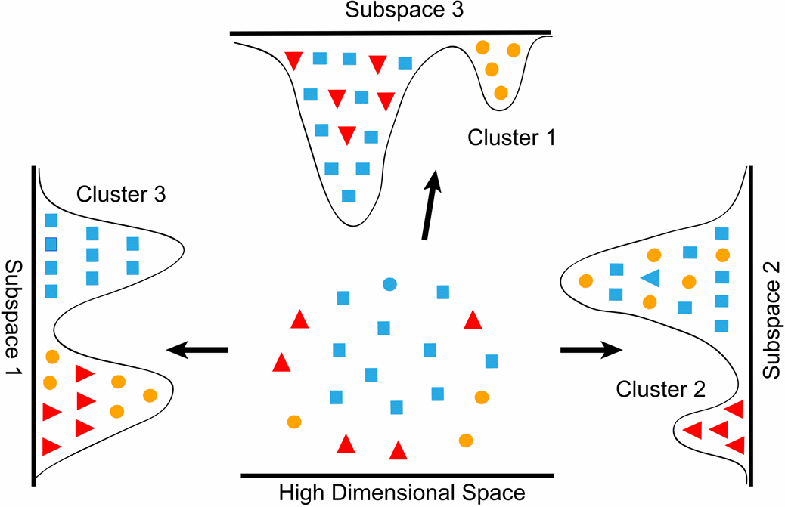
Why reduce dimensions?
Interpretability
Visualization
Computational gain for downstream use

Slide 4
Goal of this workshop
Provide high-level overview of dimension reduction methods
Provide context and application for using each method
Provide pointer to resources
Have fun!

Slide 5
Agenda
Non-negative matrix factorization | Erika | 15:00
PCA | Xiaotong | 15:00
t-SNE and UMAP | Erika & Henry | 15:00
Break |  | 15:00
Diffusion map & spectral clustering | Brittany | 15:00
Autoencoders | Henry | 15:00
Wrap-up |  | 5:00

Slide 6

Materials for this workshop
Website:
https://dimension-reduction.github.io/
Slides & code:
https://github.com/dimension-reduction/slides-and-code

Slide 7
Thank you!
Website:
https://dimension-reduction.github.io/
Slides & code:
https://github.com/dimension-reduction/slides-and-code
Please send questions
and comments to
dlee324@wisc.edu

